Slide 1
MIS 6360 Agile Project Management
Project Initiation and the Project Charter

Slide 2
Agenda
Administrative
Poll Everywhere
Initiating the Project
The Project Charter
Stakeholder Management

Slide 3
Initiating the Project

Slide 4
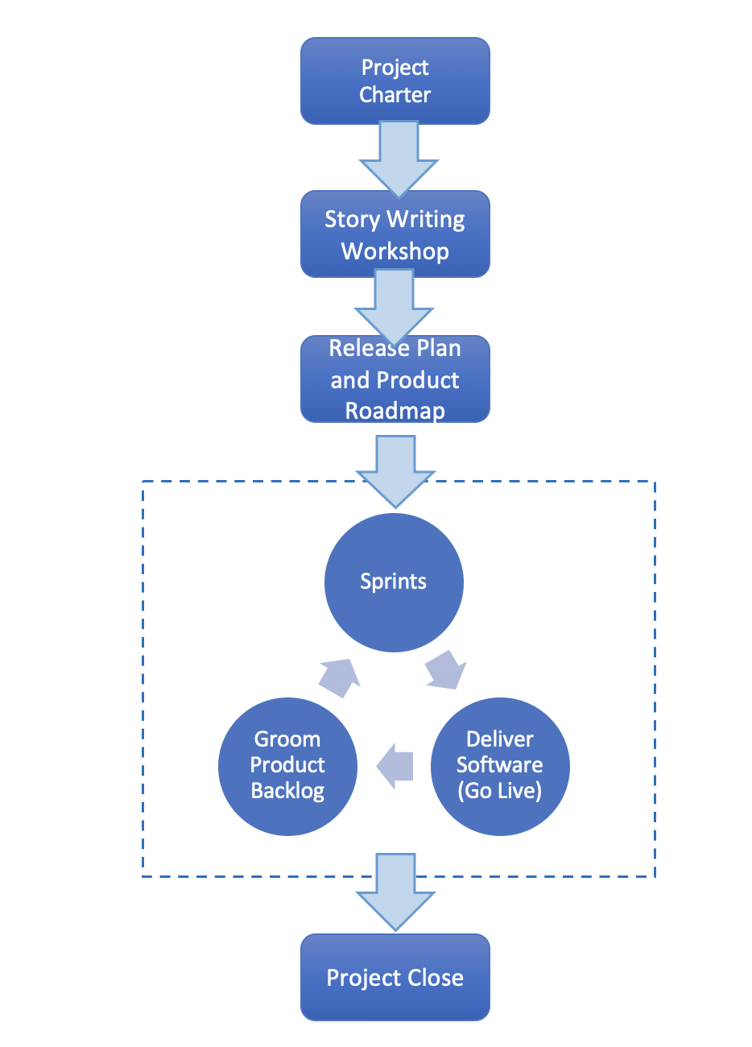
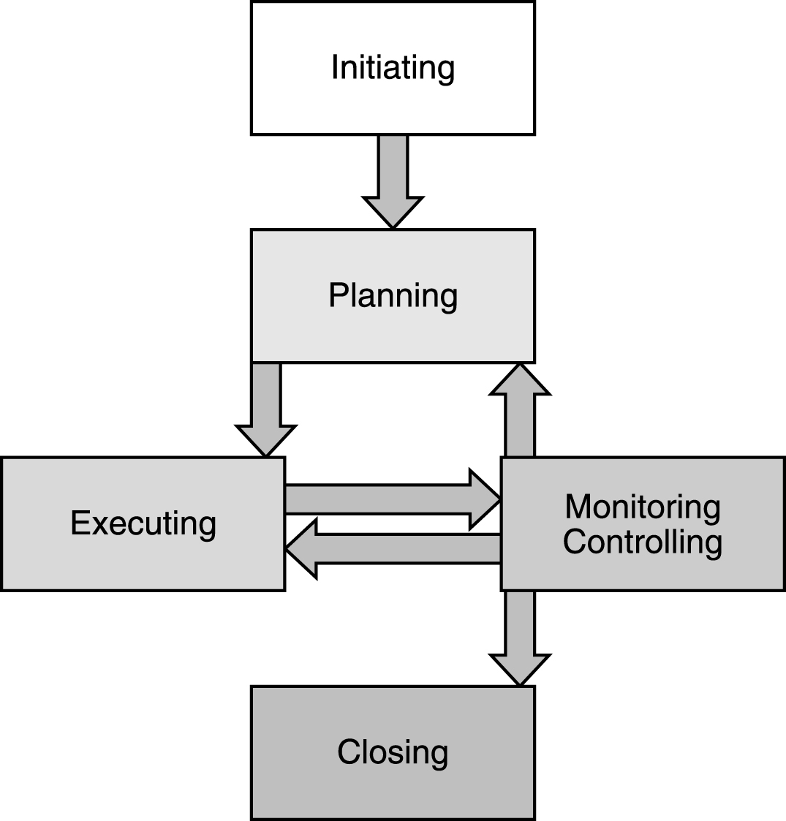
Understanding the Project Lifecycle
Planned – PMBOK
Adaptive - Scrum/Agile
PMP in Depth: Project Management Professional Study Guide for PMP and CAPM Exams

Slide 5
Initiating the Project
Business Mission, Vision and Strategy
Business Goals and Objectives
Business Need/ Opportunity
Business Case
Project Charter

Slide 6
Identifying Business Needs and Opportunities
Business Requirements
Legal or Regulatory
Opportunities
Customer Requests
Market Demand
New Technology
Problems
Address specific Problem Areas

Slide 7
Project Selection Methods
Scoring models using weighted criteria
Cost Benefit Analysis
Expert Judgment

Slide 8
Scoring Models
 | Strategic Fit | Urgency | Improve Customer Loyalty | ROI of 18% plus | Regulatory Compliance | Weighted Total
Weight | 4.0 | 2.0 | 1.0 | 5.0 | 10.0
Project 1 | 8 | 2 | 6 | 5 | 0 | 67
Project 2 | 1 | 3 | 2 | 2 | 0 | 22
Project 3 | 1 | 1 | 1 | 1 | 10 | 112
. . .
Project n | 9 | 8 | 8 | 9 | 0 | 105
Source: Adapted from Project Management by Gray and Larson

Slide 9
Cost Benefit Analysis
Cost, Revenue, and Project Savings
Can be hard to quantify value of intangibles

Slide 10
IT Benefits
Tangible Benefits
Increases in revenue
Reduction in labor costs
Reduction in supplies needed
Reduction in maintenance costs
Intangible Benefits (Difficult to Measure and Quantify)
Improvements in decision making
Improvements in communication
Improvements in compliance
Improvements in collaboration

Slide 11
IT Costs
Hardware
Software
Communication
Labor
Education and Training

Slide 12
Project Identification Exercise
Identify a software development project that you think would be beneficial for UT Dallas to undertake. Provide a short 2 – 3 sentence description of the project highlighting the proposed value and benefits of the project.

Slide 13
Project Selection Benefit Measurement
Return on Investment (ROI)
Ignoring the time value of money, the percentage of profit from the project
ROI = (Benefits – Costs) / Costs
Internal Rate of Return (IRR)
Translates yearly cost/benefit amounts to an interest rate over the life of the project
Excel IRR function
Net Present Value (NPV)
The present value of future cash inflows (benefits) minus the present value of future cash outflows (costs)
Excel NPV Function
Present Value Discount Factor = 1/(1 + r)^t where r = interest rate and t = time

Slide 14
Exercise
Calculate the ROI, NPV, and IRR of the following project. Where appropriate, assume a 10% discount rate. Should you move forward with the project?
Year | Cost | Revenue
0 | 500,000 | 0
1 | 10,000 | 5,000
2 | 10,000 | 50,000
3 | 10,000 | 75,000
4 | 10,000 | 100,000
5 | 10,000 | 125,000
6 | 10,000 | 150,000
7 | 10,000 | 150,000
8 | 10,000 | 150,000
9 | 10,000 | 150,000
10 | 10,000 | 150,000

Slide 15
Exercise
Calculate the ROI, NPV, and IRR of the following project. Where appropriate, assume a 10% discount rate. Should you move forward with the project?
Year | Cost | Revenue
0 | 1,000,000 | 0
1 | 100,000 | 50,000
2 | 100,000 | 100,000
3 | 100,000 | 200,000
4 | 100,000 | 300,000
5 | 100,000 | 350,000
6 | 100,000 | 400,000
7 | 100,000 | 450,000
8 | 100,000 | 500,000
9 | 100,000 | 550,000
10 | 100,000 | 600,000

Slide 16
Exercise – Sensitivity Analysis
Conduct an interest rate sensitivity analysis for the following project by calculating the NPV for all discount rates between 2% and 18% in 1% increments. Should you move forward with the project?
Year | Cost | Revenue
0 | 1,000,000 | 0
1 | 100,000 | 50,000
2 | 100,000 | 100,000
3 | 100,000 | 200,000
4 | 100,000 | 300,000
5 | 100,000 | 350,000
6 | 100,000 | 400,000
7 | 100,000 | 450,000
8 | 100,000 | 500,000
9 | 100,000 | 550,000
10 | 100,000 | 600,000

Slide 17
Project Selection Expert Judgment
Expert Judgment

Slide 18
Developing the Project Charter

Slide 19
Developing the Project Charter
Formally Authorizes the Project and Identifies a Project Manager
Input
Business Case
Tools and Techniques
Expert Judgment
Output
Project Charter
Contract
Enterprise Environmental Factors
Organizational Process Assets
Statement of Work
PMP in Depth: Project Management Professional Study Guide for PMP and CAPM Exams

Slide 20
Output of Developing the Project Charter
Project purpose or justification
Measurable project objectives and related success criteria
High-level requirements
High-level project description
High-level risks
Summary milestone schedule
Summary budget
Project approval requirements
Assigned project manager
Name and authority of the sponsor

Slide 21
Project Charter Templates
California Department of Technology Agile Project Charter
California Project Management Methodology
Not Perfect
Smart Sheet

Slide 22
Exercise
For the project you previously identified, create a draft project charter covering the following items.
Project Name
High-level project description including the purpose of the project
Success criteria including measurable project objectives
High-level requirements
Summary milestone schedule
Summary budget
Names of project sponsor, project manager, and product manager

Slide 23
Identifying the Project Stakeholders

Slide 24
Identifying Project Stakeholders
Project Manager
Project Management Office
Project Management Team
Project Team Members
Performing Organizations
Customer/user
Project Sponsor
Influencers

Slide 25
Stakeholder Register
Document used to store information about stakeholders
Identification – name, location, title, project role, contact information
Assessment – list of how the stakeholder will react to different scenarios
Classification – power/interest grid, power involvement/grid, involvement/impact grid, salience model

Slide 26
Stakeholder Management
The approach developed to deal with the stakeholders in the best interests of the project
How will individual stakeholders be managed?
How ill groups of stakeholders be managed?

Slide 27
Power/Interest Grid
Authority Level
Monitor Closely | Manage with maximum effort
Monitor | Keep informed
Stakeholder 4
Stakeholder 6
Stakeholder 9
Stakeholder 10
Stakeholder 5
Stakeholder 11
Stakeholder 1
Stakeholder 3
Stakeholder 7
Stakeholder 8
Stakeholder 2
Interest Level

Slide 28
Power/Interest Grid
Authority Level
Monitor Closely | Manage with maximum effort
Monitor | Keep informed
Office of Budget & Finance
Office of Facilities and Economic Development
Office of Campus Resources and Support
Office of Development and Alumni Relation
Student Affairs
Office of Information Technology
Office of Government and Community Relations
Office of the Research and Innovation
HR
University President
Office of Communications
Office of Academic Affairs and Provost
Interest Level

Slide 29
Exercise
Develop a stakeholder register for the project you identified in the previous exercise

